Slide 1
Drug Use – A – High Risk Behavior
Chapter 23
Lesson 2
Mr. Martin

Slide 2
You’ll Learn To
Define substance abuse and recognize the health risks involved.
Analyze the harmful effects of drugs on the fetus.
Analyze the harmful physical, mental/emotional, social, and legal consequences of drug use.

Slide 3
Vocabulary
Substance Abuse
Illegal Drugs
Illicit Drug Use
Overdose
Psychological Dependence
Physiological Dependence
Addiction

Slide 4
What is Substance Abuse
Substance Abuse is any unnecessary or improper use of chemical substances for nonmedical purposes.
Illegal Drugs are chemical substances that people of any age may not lawfully manufacture, possess, buy or sell.
Illicit Drug Use is the use or sale of any substance that is illegal or otherwise not permitted. This includes the selling of prescription drugs on the street.

Slide 5
Factors That Influence Decisions About Drugs
Peer Pressure
Family Members
Role Models
Media Messages
Perceptions (70% of all high school students do not use drugs)

Slide 6
The Health Risks of Drug Use
Physical Health – Once drug enters the bloodstream it can harm the brain, heart, lungs and other organs.
Mental Health – Drugs cloud reasoning and thinking. Lose sight of values, and behavior changes.
Social Health – Regret even trying it just once.

Slide 7
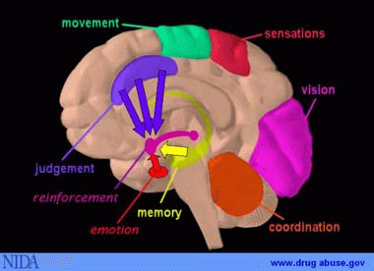

Slide 8
Understanding the Addiction Cycle
Teens who experiment with drugs will experience side-effects, or unwanted reactions. The following may occur the first time drugs are used:
Nausea
Headaches
Coma
Death

Slide 9
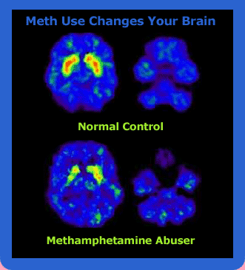

Slide 10
Understanding the Addiction Cycle
Tolerance is when the user needs more of the drug to get the same effect.
Psychological dependence when the person believes that a drug is needed in order to feel good or to function normally.
Physiological dependence is when the user has a chemical need for the drug.
Withdrawal symptoms: nervousness, insomnia, severe nausea, headaches, vomiting, seizures, death.

Slide 11
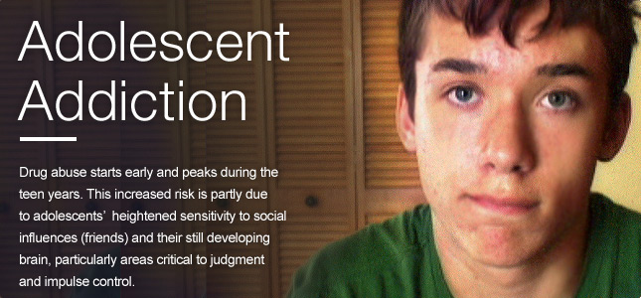
Understanding the Addiction Cycle
Addiction is a physiological or psychological dependence on a drug.

Slide 12
Other Consequences of Drug Use
Mental Health
Crimes
Suicide
High Risk Behaviors
STD’s
Unwanted pregnancy
Legal consequences
Consequences for family and friends
Consequences for babies and children

Slide 13
Costs to Society
Crimes that are committed against society are expensive.
More police
Drug courts
Vandalism
Theft
Jail
Injuries/Death
Mental Illness

