Slide 1
Marijuana, Inhalants, and Steroids
Chapter 23
Lesson 3
Mr. Martin

Slide 2
You’ll Learn To
Analyze the physical, mental, social and legal consequences of using marijuana, steroids, and inhalants.
Analyze and apply strategies for avoiding the use of marijuana, inhalants, and steroids.
Explain the negative effects of combining alcohol use with marijuana use.

Slide 3
Vocabulary
Marijuana
Paranoia
Inhalants
Anabolic-androgenic steroids

Slide 4
Marijuana
Marijuana is a plant whose leaves, buds and flowers are smoked for their intoxicating effects.
Marijuana is the most common drug used (behind alcohol).
If a person has used marijuana they are 17 times more likely to try cocaine.
Hashish is a stronger form of marijuana.

Slide 5
D-Alpha-Tetrahydrocannainol
THC is the active ingredient in marijuana.
Marijuana contains 421 different chemicals.
THC is stored in the fat and traces of it can be found in the blood for up to a month.
Hair and Drug Testing
What happens at the lab

Slide 6
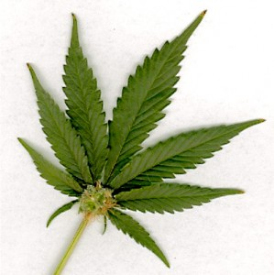
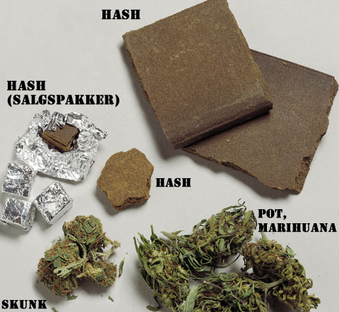
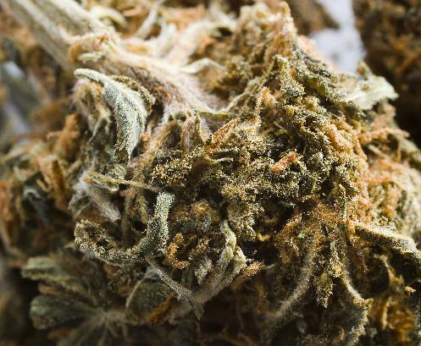
Marijuana and Hashish

Slide 7
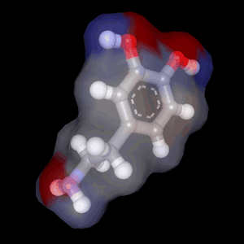
Marijuana and Addiction
Marijuana raises the levels of dopamine in the brain. Dopamine is a chemical that increases pleasure.
Marijuana also interferes with the immune system and makes the user more susceptible to infections.

Slide 8
Health Risks of Marijuana
Hallucinations and paranoia
Impaired concentration, memory
Distorted sense of time, sight, touch, sound
Decreased ambition
Heart and lung damage
Weakened immune system
Increased risk of still births
Risk on infertility

Slide 9
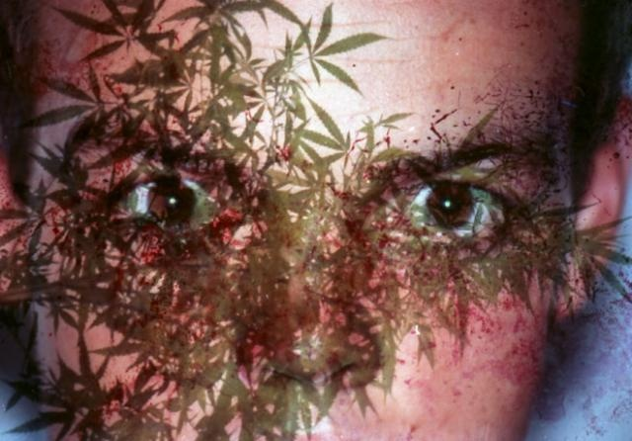
Paranoia
Paranoia is an irrational suspiciousness or distrust of others.

Slide 10
Inhalants
Inhalants are substances whose fumes are sniffed and inhaled to achieve a mind-altering effect.
Most inhalants go immediately to the brain and kill brain cells.
Inhalants

Slide 11
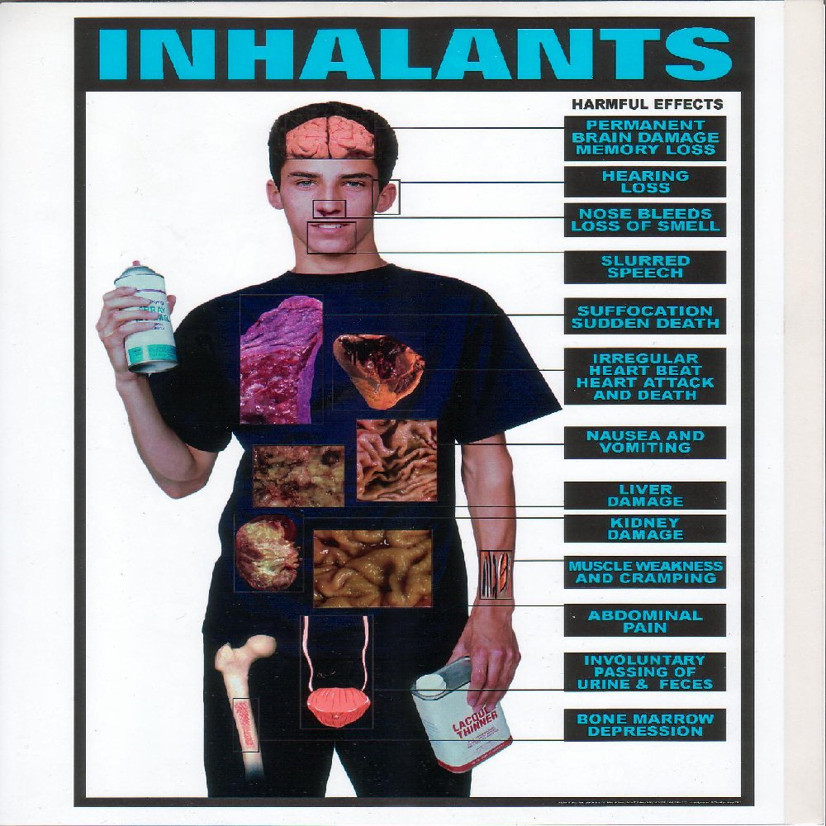

Slide 12
Inhalant Examples
Solvents
Aerosols
Glues
Spray paint
Gasoline
Varnishes

Slide 13
Effects of Inhalants
Inhalants depress the CNS. Example effects:
Glassy stare
Slurred speech
Impaired judgment
Inhalants (Huffing) can increase heart that results in cardiac arrest and death by suffocation.

Slide 14
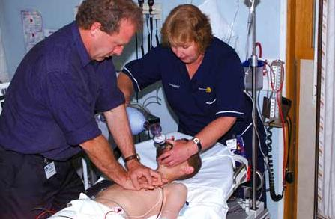
What is Cardiac Arrest
Cardiac arrest is the sudden, abrupt loss of heart function. The victim may or may not have diagnosed heart disease. It's also called sudden cardiac arrest or unexpected cardiac arrest. Sudden death (also called sudden cardiac death) occurs within minutes after symptoms appear.

Slide 15
Anabolic – Androgenic Steroids
Anabolic – Androgenic Steroids are synthetic (man made) substances that are similar to the male sex hormone testosterone.
Anabolic refers to muscle building.
Steroids can and do have legitimate medical benefits if used accordingly.

Slide 16
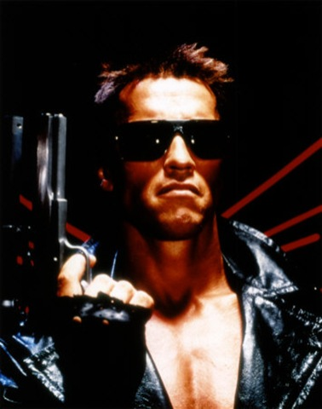
Negative Effects of Steroid Use
Mood Swings
Zits
Heart Damage
Rage
Feeling of Invincibility
Paranoia
Legal and Social Consequences.

Slide 17
Steroids
Steroids

