Slide 1
Psychoactive Drugs
Chapter 23
Lesson 4
Mr. Martin

Slide 2
You’ll Learn To
Examine the harmful effects of psychoactive drugs on body systems.
Explain the role psychoactive drugs play in putting teens in unsafe situations that include the risk of HIV, STD’s, or unplanned pregnancies.
Analyze the importance of alternatives to drug use.
Analyze and apply strategies for avoiding psychoactive drugs.

Slide 3
Vocabulary
Psychoactive drugs
Stimulants
Euphoria
Depressants
Narcotics
Hallucinations
Designer drugs

Slide 4
Psychoactive Drugs
Psychoactive drugs are chemicals that affect the cns and alter activity in the brain.
There are four main groups of psychoactive drugs:
Stimulants
Depressants
Narcotics
Hallucinogens

Slide 5
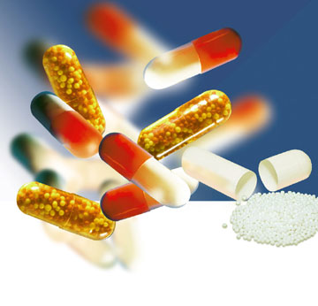
Health Risks of Stimulants
Stimulants are drugs that speed up the central nervous system.
Stimulants can be used with medical conditions such as hyperactivity.

Slide 6
Cocaine
Cocaine us a rapid-acting, powerful, highly addictive stimulant that interrupts the normal functioning of the CNS.
Purchasing, possession or using cocaine is illegal.
Cocaine is a white powder that comes from the coca plant.
Cocaine users experience self-confidence and euphoria. Euphoria is a feeling of intense well being or elation.
Cocaine

Slide 7
Cocaine
Effects of cocaine last 20 minutes to several hours. Emotional let down after effects disappear.
Regular use can lead to depression, fatigue, paranoia, and physiological dependence.
Cardiac problems can occur and septum can collapse.
Overdosing can result in cardiac arrest, respiratory failure, seizures and death.

Slide 8
Coca Plant

Slide 9
Crack
Crack is very pure form of cocaine.
This is one of the most deadliest drugs.
It can be smoked or injected.
It reaches the brain within seconds.
Extremely addictive.
Crack Cocaine

Slide 10
Crack

Slide 11
Amphetamines
Amphetamines are stimulants used in prescription medicines to reduce fatigue and drowsiness or to suppress appetite.
Easily develop tolerance.
Effects of use include:
Irregular heartbeat
Twitching
Paranoia
Heart and blood vessel damage.

Slide 12
Methamphetamine
Methamphetamine is a stimulant that is used to treat certain disorders such as Parkinson’s disease and obesity and ADHD.
Incredibly dangerous and highly addictive.
Effects include:
Paranoia
CNS damage
Blood pressure
Damage to brain cells
Teeth damage
Death

Slide 13
Methamphetamine
What causes Drug Triggers?
Meth and Anger
Brief History Of Amphetamines
Faces of Meth

Slide 14
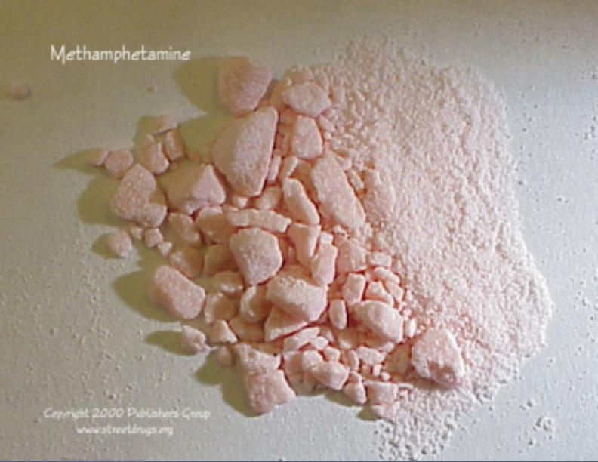
Meth

Slide 15
Meth Mouth

Slide 19
Depressants
Depressants or sedatives are drugs that slow down the CNS.
Depressant drugs relax muscles, relieve tension, worry, and cause drowsiness.
They can slow the heart rate, lower blood pressure to dangerous levels, and interrupt with normal breathing rates.
ALCOHOL IS A DEPRESSANT!

Slide 20
Depressants
Two types of Sedative Medications
Barbiturates
Tranquilizers
Mixing depressants together produces a synergistic effect and can be fatal.

Slide 21
Barbiturates & Tranquilizers
Barbiturates are a sedative-hypnotic drug.
They induce sleepiness.
Can be fatal.
Tranquilizers are depressants that reduce muscular activity, coordination, and attention span.
Tranquilizers are prescribed to relive:
Anxiety
Muscle spasms
nervousness/sleeplessness
Highly addictive and withdrawal can occur resulting in shakiness.

Slide 22
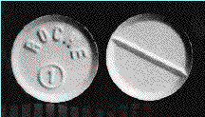
Rohypnol
Rohypnol is a depressant.
Rohypnol is a club-drug. (Date-Rape-Drug)
Can be 10 times stronger than tranquilizers.
Tablet form and looks like an aspirin.
Easily dropped into beverage.
Victim wakes up with no recollection of what happened.
STD’s, HIV, unwanted pregnancies.

Slide 23
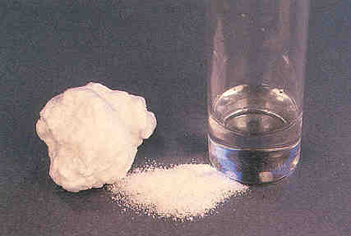
GHB
GHB is a depressant.
Date-Rape-Drug.
Powder or liquid form.
A person can overdose easily on GHB.
Leaves the body quickly so it is hard for medical people to determine that an overdose has occurred.
GHB Clip

Slide 24
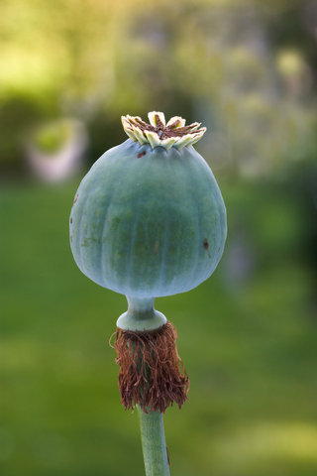
Narcotics
Narcotics are specific drugs derived from the opium plant that are obtainable only by prescription and are used to relieve pain.
Narcotic Examples:
Morphine
OxyContin
Codeine (found in some cough medicines)
Narcotics are highly addictive.

Slide 25
Heroin
Heroin is a highly addictive narcotic that is a processed form of morphine.
It is injected, snorted or smoked.
Depresses the CNS and slows breathing and pulse rate.
Causes damage to the heart and liver.
Susceptible to HIV, Hepatitis B infection.
Large doses can cause death.
Users easily develop a tolerance.

Slide 26
LSD
LSD is an extremely strong hallucinogen.
Tiny amounts are very powerful.
LSD affects the brains emotional center and distorts reality. Emotions can range from euphoria to panic and to deep depression.
Flashbacks can occur.

Slide 27
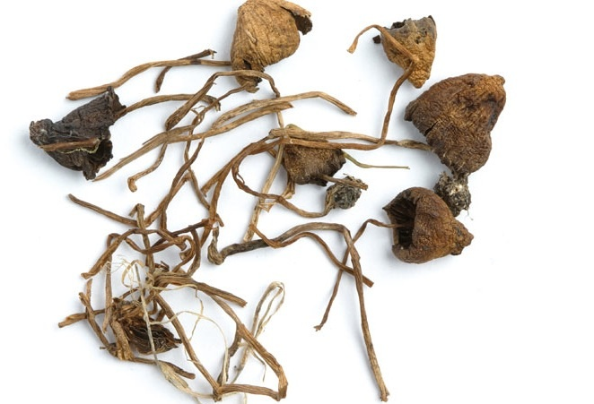
Hallucinogens
Hallucinogens are drugs that alter moods, thoughts, and sense perceptions including vision, hearing, smell, and touch.
They have no medical use.
They impair judgment and reasoning.
Alters mental states that can last for several hours or several days.

Slide 28
Hallucinogens
PCP is one of the most dangerous drugs.
Users report distorted sense of time and space, increased muscle strength, and the inability to feel pain.
Flashbacks can occur at anytime causing panic, confusion and lack of control.
Death can occur from PCP overdose.
Some people have died in fires because they could not feel the pain.

Slide 29
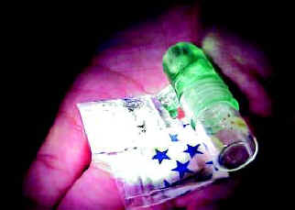
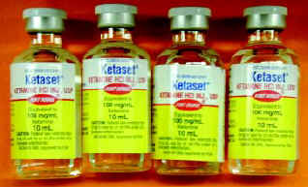
Ketamine
Ketamine is an anesthetic used for medical purposes, mostly in treating animals.

Slide 30
Designer Drugs
Designer drugs are synthetic substances meant to imitate the effects of hallucinogens and other dangerous drugs.
Examples:
Ecstasy (X, E, XTC, Adam, MDMA)
Ketamine (K, ket, special K, vitamin K, cat valium)

Slide 31
What are some consequences of drug use?
Unwanted pregnancy
STD’s
Health problems
Addiction
Unintentional injuries

