Slide 1
Sexually Transmitted Infections and HIV/AIDS
Chapter 25
Mr. Martin

Slide 2
A person can get an STD only through having sex with many people.
True
False

Slide 3
Myth
People can get an std from just one sexual contact.

Slide 4
Abstinence from sexual activity is 100 percent effective in preventing STDs and the sexual transmission of HIV and hepatitis B.
True
False

Slide 5
All STD’s are Curable

Slide 6
Myth
Some types of STDs are incurable and last a lifetime.

Slide 7
Anyone with an STD will have symptoms.
True
False

Slide 8
Myth
Some STDs have no symptoms, especially early on.

Slide 9
Many symptoms of HIV/AIDS go unreported.
True
False

Slide 10
A person can have only one type of an STD at a time.
True
False

Slide 11
Myth
A person can have several STDs at a time.

Slide 12
After a person has been treated for an STD, he or she can’t get it again.
True
False

Slide 13
Myth
People do not become immune to most STDs.

Slide 14
Untreated STDs can lead to difficulty in having children.
True
False

Slide 15
Nationwide, STDs are on the rise among teens.
True
False

Slide 16
Cowlitz County has the highest STD rate in the State.
True
False

Slide 17
Unfortunately It’s True

Slide 18
The Risk of STIs
Chapter 25 Lesson 1
Mr. Martin

Slide 19
You’ll Learn To
Explain the relationship between alcohol and other drugs used by adolescents and the role these substances play in STDs.
Analyze the importance and benefits of abstinence as it related to the prevention of STDs.
Discuss abstinence from sexual activity as the only method that is 100 percent effective in preventing STDs.
Develop and analyze strategies related to the prevention of STDs.

Slide 20
Vocabulary
Sexually Transmitted Diseases
Sexually Transmitted Infections
Epidemics
Abstinence
Communicable Disease
Non-Communicable Disease

Slide 21
Communicable Diseases
STIs or STDs are a communicable disease.
A communicable disease is a disease that can be spread from person to person.
A Non-Communicable disease is a disease that cannot be spread from person to person.
Examples:
Cancer
Heart Disease

Slide 22
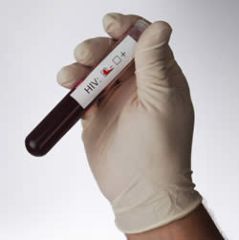
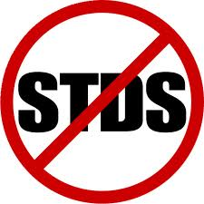
Sexually Transmitted Diseases
Sexually Transmitted Diseases also known as Sexually Transmitted Infections, are infectious diseases spread from person to person through sexual contact.

Slide 23
Epidemics
Epidemics are occurrences of disease in which many people in the same place at the same time are affected.
It is estimated that 65 million people in the U.S. are living with an incurable STD.
Many of the these cases go undiagnosed and untreated. Why do you think this is so?

Slide 24
Some STD’s Are Asymptomatic
Asymptomatic means without symptoms.
A vid or two?
That's gotta hurt!
What the .....

Slide 25
High-Risk Behavior and STDs
Being sexually active with more than one person.
Engaging in unprotected sex.
Selecting high-risk partners.
Using alcohol and drugs.

Slide 26
High-Risk Behavior and STDs

Slide 27
Consequences of STDs
Some STDs are incurable.
Some STDs cause cancer.
Some STDs can cause complications that affect the ability to reproduce.
Some STDs can be passed from an infected female to her child before, during, or after birth.
It can change your life forever.

Slide 28
Preventing STDs Through Abstinence
Abstinence is the deliberate decision to avoid harmful behaviors, including sexual activity before marriage and the use of tobacco, alcohol and other drugs.

