Slide 1
HIV and AIDS
Chapter 25
Lesson 4
Mr. Martin

Slide 2
You’ll Learn To
Understand the differences between HIV and AIDS.
Explain how HIV affects and destroys the immune system.
Identify behaviors known to transmit HIV.
Analyze the relationship between unsafe behaviors, refusal skills, and the risk of HIV.

Slide 3
Vocabulary
Acquired Immune Deficiency Syndrome (AIDS)
Human Immunodeficiency Virus (HIV)
Opportunistic Infection

Slide 4
Changing Faces of AIDS
HIV/AIDS (First identified in 1981)
As of June 2000, over 753,000 Americans had been diagnosed with AIDS, 58 percent of whom have already died.
Today it is estimated that 1 in 250 people are infected with HIV.
It takes an average of 10-12 years before a person with HIV becomes physically debilitated by AIDS.
Non-Progressors are people that are in infected with HIV but never develop symptoms.

Slide 5
Human Immunodeficiency Virus
HIV is the acronym for Human - Immunodeficiency - Virus
HIV is a virus that attacks the immune system.

Slide 6
AIDS
AIDS is an acronym for:
Acquired – Not inherited, Acquired
Immune - Body’s Defense System
Deficiency – Lack of Body’s Immune System
Syndrome – Collection of illnesses, when they occur together, are characteristic of a particular disease.

Slide 7
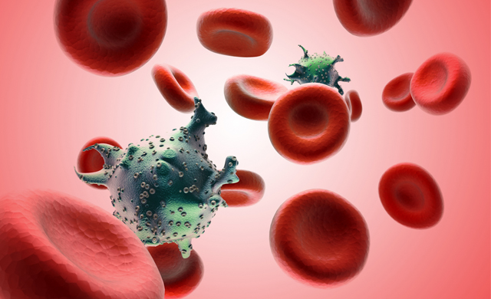
AIDS
Over a period of years after initial infection, the presence of HIV weakens the immune system, leading to a number of symptoms and illnesses that, when taken together, result in a diagnosis of AIDS.

Slide 8
How HIV Works in the Body
When HIV enters the body it seeks out and destroys the immune cells.
It enters the immune cell, duplicates itself, and then repeats the process until the persons immune system is so weak that he or she can no longer fight off disease or infections.
HIV infection is progressive meaning that it may take months or years to destroy the immune system.

Slide 9
How is HIV Transmitted
Sexual Intercourse
Having STDs increases chances of getting HIV
Sharing needles
Mother to baby
Blood
Milk

Slide 10
Stages of HIV Infections
Half of all people infected begin to show signs within 3-6 weeks of being infected.
Fever
Rash
Headache
Aching
The symptoms then disappear.

Slide 11
Stages of HIV Infections
When symptoms disappear the asymptomatic stage begins. This person may show no symptoms for 6 months to 10 years.
Symptomatic stage is when symptoms appear because of severe drop in immune cells.
AIDS is the last stage. Immune system is damaged, opportunistic infections take place.
HIV attacks brain cells causing difficulty thinking and remembering.

Slide 12
Opportunistic Infections
Opportunistic Infections are infections that occur in individuals who do not have a healthy immune system.
HIV does not mean that at an individual has AIDS.
AIDS is the advanced stage of HIV infection.

Slide 13
HIV Is Not Been Spread By
Shaking hands
Hugging
Kissing (unless open sore in mouth is present)
Sweat
Sneezing
Insect bites

Slide 14
Teens at Risk
Just because you don’t hear much about AIDS anymore does not mean that it does not exist.
The best way to protect yourself from AIDS, HIV, STD’s, and unwanted pregnancy is through ABSTENINCE.

Slide 15
HIV/AIDS Review
HIV/AIDS Part One
HIV/AIDS Part Two
HIV/AIDS Part Three
HIV/AIDS Part Four

Slide 16
Confessions
Story One
Story Two

Slide 21
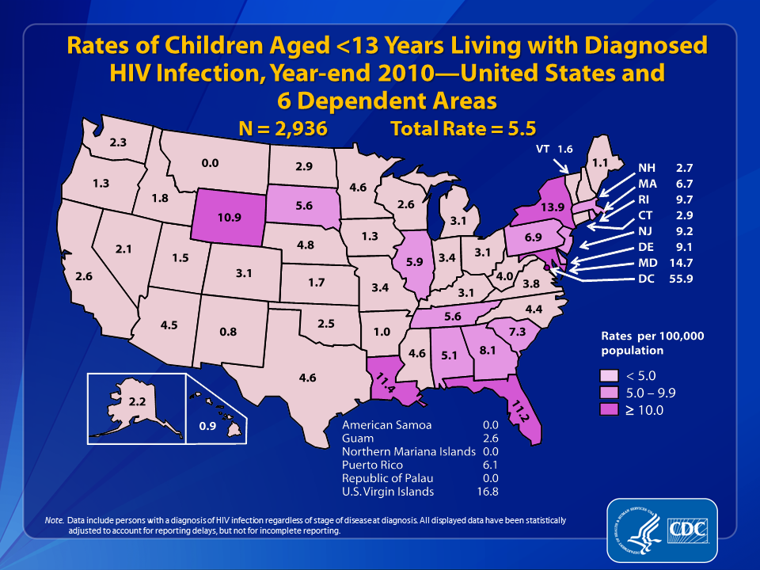

Slide 22
Treatment for HIV and AIDS
Chapter 25
Lesson 4
Mr. Martin

Slide 23
You'll Learn To
Explain how technologies such as new drug treatments have impacted the health status of people with HIV.
Compare and analyze the cost, availability, and accessibility of heath services worldwide for people living with HIV\AIDS.
Demonstrate strategies to practice abstinence and to refuse pressure to engage in sexual activity or drug use.

Slide 24
Detecting HIV
EIA Test
Looks for a specific antibody in the blood.
False negative is common.
Western Blot
Most common test in the United States.
If done properly 100% accurate.

Slide 25
HIV/AIDS Global Picture
At the end of 2001, it was estimated 40 million people were infected with HIV.
This means that HIV is a pandemic.
Pandemic is a global outbreak of infectious disease.

Slide 26
How to Protect Yourself from HIV/AIDS
Abstinence
Abstinence
Abstinence
Don’t use drugs and or get yourself in a pressured situations.
Use refusal skills, you have the POWER unless you give your POWER away!

Slide 27
Vocabulary
Asymptomatic stage
Symptomatic stage
EIA
Western Blot
Pandemic

