Slide 1
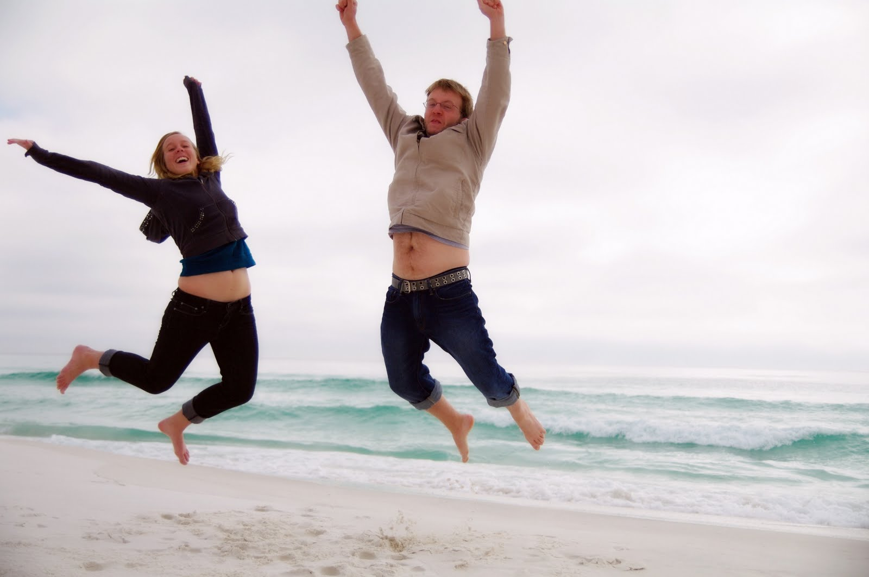
Welcome…………
Might as Well Jump

Slide 2
Safe Room
This is a safe room
We talk about sensitive issues
What we talk about in here – stays in here
Respect others comments and questions
Please don’t talk while others are speaking.
Learning doesn’t have to be boring.
So Let’s Have Some FUN!!!!!!!

Slide 3
Mr. Martin's Website

Slide 4
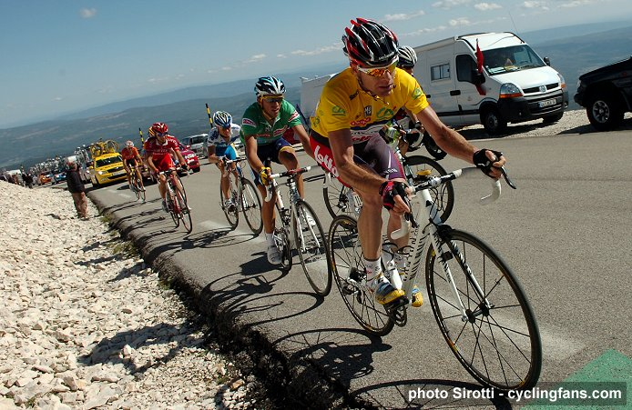
Physical Activity and Your Health Chapter 4 Lesson 1
Freshman Health
Mr. Martin

Slide 5
You’ll Learn To
Understand the importance of regular physical activity.
Examine the effects of regular physical activity on body systems.
Analyze the relationship between regular physical activity and disease prevention.
Discover ways to incorporate physical activity into daily life.

Slide 6
Vocabulary
Physical activity
Physical fitness
Sedentary lifestyles
Osteoporosis
Metabolism

Slide 7
What is Physical Activity?
Physical activity is a form of movement that causes your body to use energy.
What is Physical Activity?
Health is not a one semester class it’s ………

Slide 8
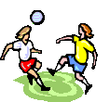
Physical Fitness
The ability to carry out daily tasks easily and have enough energy to respond to unexpected demands.
Is this an example of physical fitness?
Get up, watch and participate

Slide 9
What's the Difference Between Physical Fitness & Physical Activity?
Physical Fitness - carry out daily tasks easily and have enough energy to respond to unexpected demands.
Physical Activity - movement that causes your body to use energy.

Slide 10
How can exercise be beneficial for the entire body?
Stronger heart
Lose weight
Increased self self-confidence
Increases metabolism
Decreases stress
Increases bone density (reduce osteoporosis)

Slide 11
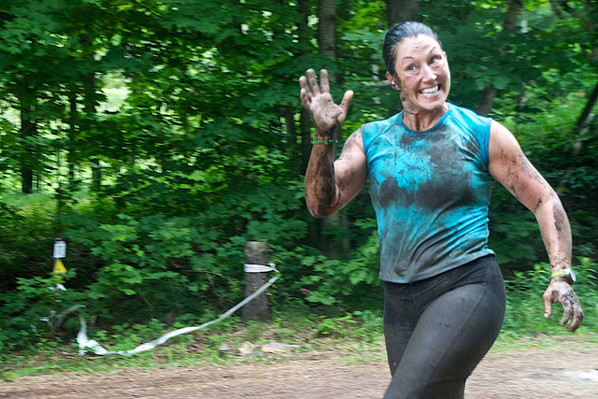
How Exercise Benefits the Cardiovascular System
When you exercise your cv system you are strengthening your heart.
Your heart gets stronger so it can pump more blood and pump the blood more efficiently.
Cardiovascular System

Slide 12
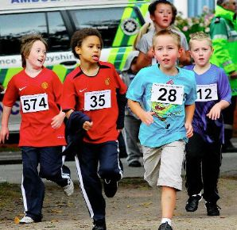
How Exercise Benefits The Respiratory System
Helps deliver oxygen to cells.
Strengthen respiratory muscles
Improves lung capacity.
Your muscles receive more oxygen.
Waste leaves muscles quicker.
Respiratory System

Slide 13
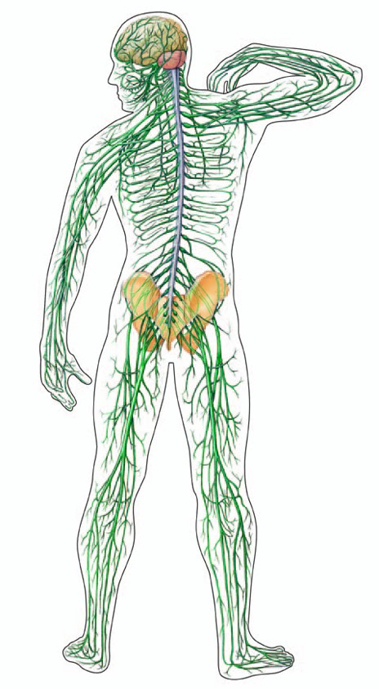
How Exercise Benefits The Nervous System
Helps you respond to stimuli more quickly.
Improves reaction time.
Reaction Time Increases

Slide 14
How Exercise Benefits Mental Health
Reduce stress
Manage anger and frustration.
Releases chemicals in brain that makes you feel better.
Increases self confidence.
Reduces mental fatigue.
Increases ability to concentrate and think more clearly.

Slide 15
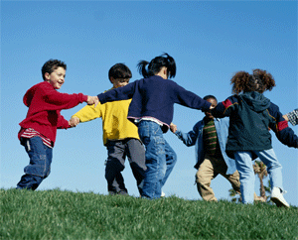
How Exercise Benefits Social Health
Builds self confidence, helps you cope better with social situations.
Opportunity to meet and interact new people.
Help you enhance relationships. (?????)

Slide 16
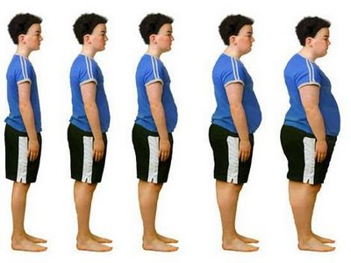
Risks from Physical Inactivity
Unhealthful weight gain
Diabetes
Cancer
Cardiovascular disease
Increases risk of osteoporosis
Reduced ability to manage stress

Slide 17
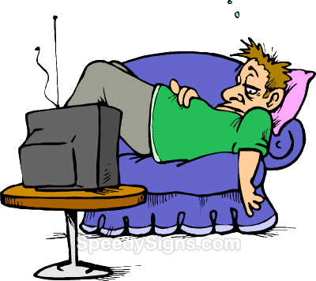
Sedentary Lifestyle
A way of life that involves little or no physical activity.
Sedentary Lifestyle Change
Osteoporosis is a decrease in bone density that makes one more susceptible to bone fractures.
Diabetes is a disorder that prevents the body from converting food into energy.

Slide 18
Physical Activity and Weight Control
Exercising increases metabolism. The rate at which body gets energy from food.
If you are sedentary you burn less calories.
If you are more active you burn more calories.
Which are you? Less or more?
As you age your metabolism automatically slows on its own.

Slide 19
Exercise is good for you and it can be fun. All you have to do is find the activity that you like and stick with it.

Slide 20
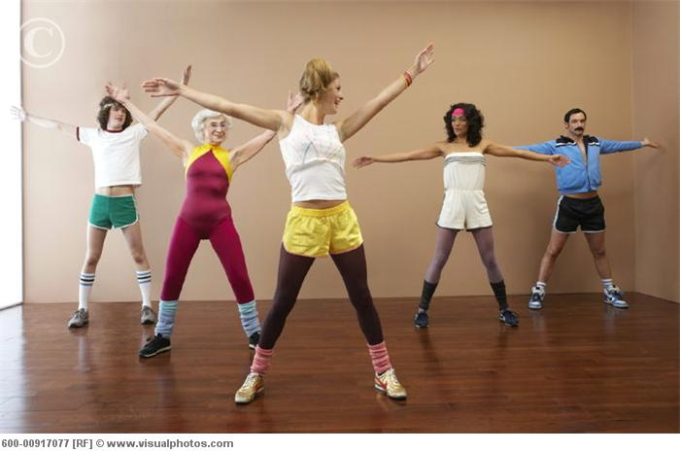
How Can You Include Physical Activity into Your Lives?
Walk
Run
Jog
Swim
Hike
Play soccer, basketball, volleyball.
How do you exercise???

Slide 21
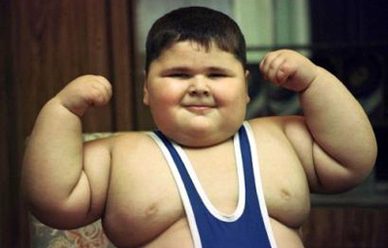
What are some negatives of living a sedentary life?
Gain unhealthy weight.
Increase chance of getting disease.
Decreases self-confidence.

Slide 22
Why is regular exercise good?
What is the relationship between regular physical activity and disease prevention.
What are some ways that you can incorporate physical activity into your daily life?

Slide 23
Your Assignment
Complete questions 1 – 5 on page 79.
Due at the start of class on Monday.
Prepare for the quiz.
Extra credit question will be posted on website.

