Slide 1
Physical Activity Injuries
Nike Animation Man Chapter 4
Lesson’s 4 & 5
Mr. Martin

Slide 2
You’ll Learn To
Identify weather related risks associated with various activities.
Analyze strategies for preventing and responding to accidental injuries.
Identify physical activity injuries requiring professional health services for people of all ages.

Slide 3
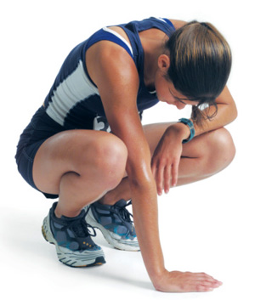
Vocabulary
Overexertion
Hydration
Steroids
Heat cramps
Heatstroke
Frostbite
Hypothermia
Muscles cramps
Tendonitis
Concussion
Strain
Sprain

Slide 4
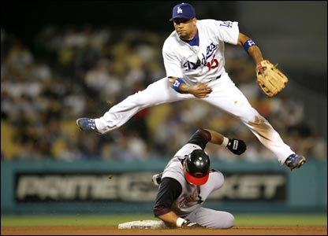
What Is A Training Program?
A Training Program is a formalized program that prepares one for involvement in a sport or other activity.

Slide 5
Nike Waffle-Sole Story
Nike Waffle Sole Story

Slide 6
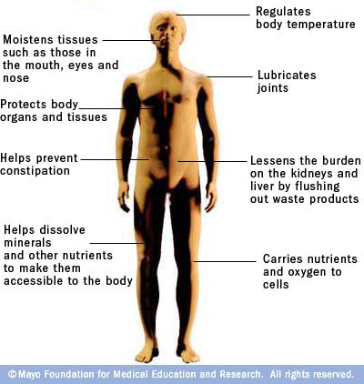
What is Hydration
Taking in fluids so that your body functions properly.

Slide 7
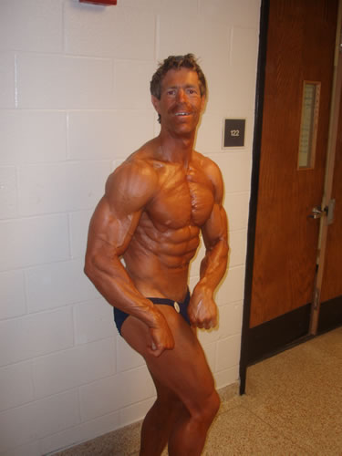
What are Anabolic Steroids?
Anabolic Steroids are synthetic substance (man made) that are similar to the male hormone testosterone.

Slide 8
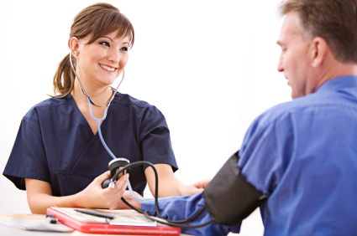
Health Screening
Health Screening is checking for diseases or disorders that an individual would otherwise not have knowledge of or seek help.

Slide 9
Hot-Weather Health Illnesses
Overexertion is simply overworking the body.
Symptoms
Cold clammy skin
Dizziness
Headache, Shortness of breath
Nausea
If overexertion is suspected:
Stop exercising
Get in the shade
Drink water

Slide 10
Hot-Weather Health Illnesses
Heat cramps are painful, involuntary muscle spasms that usually occur during heavy exercise in hot environments. Inadequate fluid intake often contributes to heat cramps.
If you suspect heat cramps:
Rest briefly and cool down
Drink clear juice or an electrolyte-containing sports drink
Practice gentle, range-of-motion stretching and gentle massage of the affected muscle group
Call your doctor if your cramps don't go away in one hour

Slide 11
Hot-Weather Health Illnesses
Heatstroke is a condition in which the body loses the ability to rid itself of excessive heat through perspiration. This is caused by a sudden increase in body temperature (hyperthermia).
How To Care For Heat Stroke

Slide 12
Heatstroke
If you suspect heatstroke:
Move the person out of the sun and into a shady or air-conditioned space.
Dial 911 or call for emergency medical assistance.
Cool the person by covering him or her with damp sheets or by spraying with cool water. Direct air onto the person with a fan or newspaper.
Have the person drink cool water, if he or she is able.

Slide 13
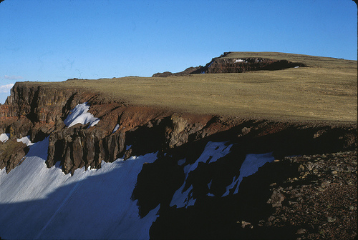
My Experience With Heat Stroke

Slide 14
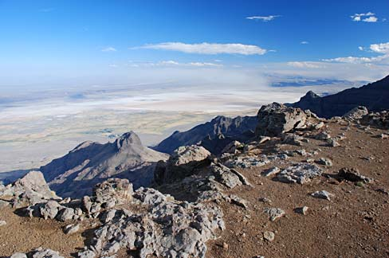

Slide 15
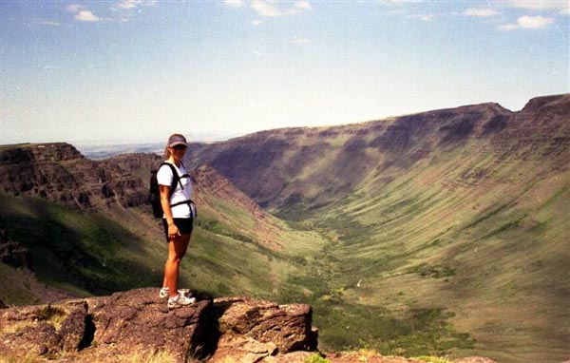

Slide 16
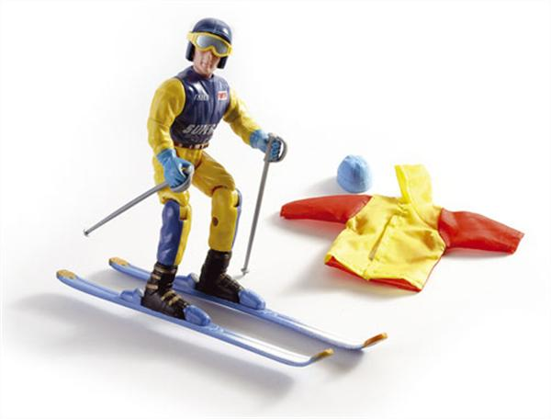
Ways to Prevent Cold Related Illnesses
When exercising in cold weather dress in layers.
70% of the body’s heat is lost through the head.
Stay hydrated.

Slide 17
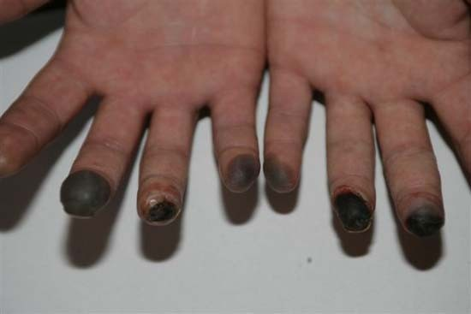
Cold Related Illnesses
Frostbite is a condition that results when body tissues become frozen and it requires professional attention. Frostbite Example How to treat Frostbite

Slide 18
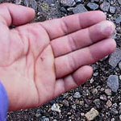
Cold Related Illnesses
Frostnip is a whitening of the skin of the toes, fingers, ears and nose.
Lack of feeling may occur
Get indoors and warm the area slowly with warm water.

Slide 19
Cold Related Illnesses
Hypothermia is a condition in which body temperatures become dangerously low.
This is associated with cold weather but can also result from exposure to wind and rain.
As hypothermia occurs the body is unable to warm itself and the body temperature drops.
Hypothermia requires immediate attention.
Shivering is a sign that your body is losing heat.

Slide 20
Protecting Yourself from Sun & Wind
Sun and wind can cause burns
Too much exposure to sun can cause skin cancer.
Most dangerous time of the day is between 10:00 AM and 4:00 PM
How to protect yourself:
Cover body
Use sunscreen and lip balm
Reapply sunscreen and lip balm

Slide 21
Minor Injuries
Minor injuries include:
Muscle Cramps
Strain
Sprain

Slide 22
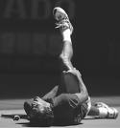
Muscle Cramps
A Muscle Cramp is a spasm or sudden tightening of a muscle.
This occurs when the muscle is tired, overworked or dehydrated.
Drinking cool water may ease cramping

Slide 23
Strain
A strain is a condition resulting from damaging a muscle or tendon.
Symptoms include soreness of a couple of days.

Slide 24
Sprain
A sprain is an injury to the ligament surrounding a joint.
Symptoms of a sprain include:
Pain
Swelling
Difficulty Moving

Slide 25
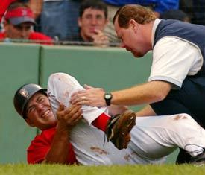
Major Injuries
Major injuries include:
Fractures and Dislocations
Tendonitis
Concussions

Slide 26
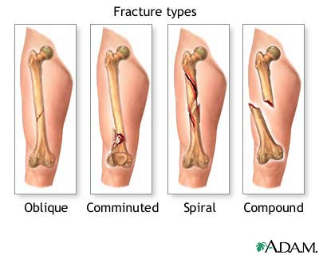
Fractures
Fractures are breaks in the bone.

Slide 27
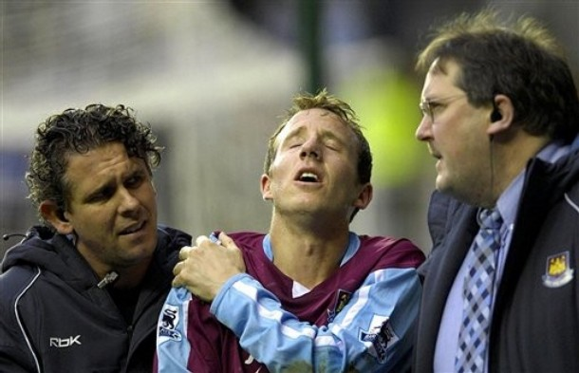
Dislocation
Dislocations result when a bone is forced from its normal position at a joint.

Slide 28
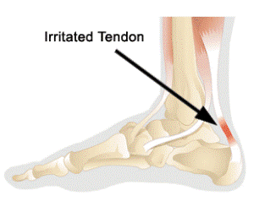
Tendonitis
Tendonitis is a condition in which the tendons, bands of fiber that connect muscles to bones, are stretched or torn from overuse.

Slide 29
Concussions
Concussions are results from blows to the head and can cause swelling of the brain, resulting in unconsciousness or even death.
If you receive any blow to the head see a health professional.

Slide 30
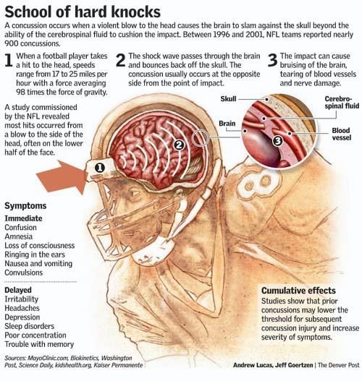

Slide 31
Treatment for Minor Injuries
The R.I.C.E. Procedure
Rest
Ice
Compression
Elevation

Slide 32
The R.I.C.E. Procedure
Rest (Avoid using the affected muscle or joint for a couple of days). This may mean that you stop exercising for a short period of time.

Slide 33
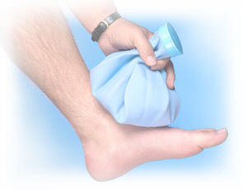
The R.I.C.E. Procedure
Ice (Ice helps reduce swelling). Place ice in a bag or in a towel and place on affected area for 20 minutes. Remove ice for 20 minutes and reapply ice for another 20 minutes.)
Repeat every three hours for 72 hours if needed.

Slide 34
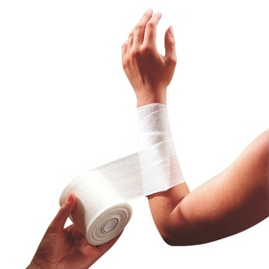
The R.I.C.E. Procedure
Compression Light pressure can help reduce swelling. Be sure the wrap is not to tight so that it cuts off blood circulation. Loosen the wrap while sleeping.

Slide 35
The R.I.C.E. Procedure
Elevation (Raising the affected injury above the heart helps reduce pain and swelling.)

Slide 36
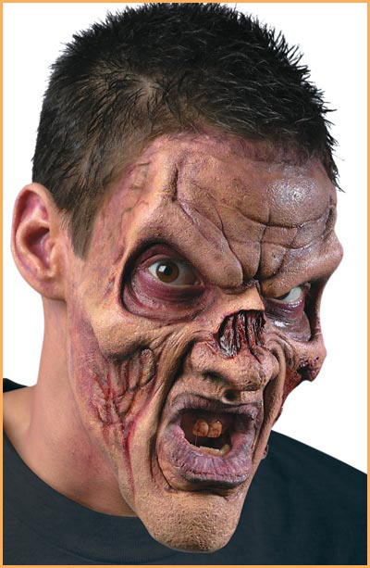
Your Assignment
Chapter 4 Review
Page 106 all questions and
questions 4-15 on page 107

